Slide 1


Cover page
‡
◊
e-Manifest Energized Reboot
3..2..1.. Lift off! Bring e-Manifest into your business
Iowa SGP – 08 June 2023
Marcus Rivas
US EPA - Kansas City
Notes:
Foremost – THANK YOU for inviting me here today! I greatly appreciate your time and attention to environmental stewardship!
Thanks to David Graham and Scott Christian at EPA HQ and Colleen Thomas in R7 Office for their help and support in putting this together!
I understand that these slides (complete with speaker notes) will be made available to you by Jeff and Dan. I’ll be here for the entire workshop to help and answer questions on e-Manifest. My contact info is at the end of this slide deck . I also have business cards for those who might want one.
The green highlighted double cross indicates there are speaker notes for the slide.
The blue highlighted diamond indicates there is an animation for the slide.

Slide 2

SUMMER BY THE SEA COLORING BOOK – PICTURE 1
‡
Agenda
Happenings
Registering
Updates
Notes:
These are the things I’ll be talking about this morning. And then there should be plenty of time to explore your questions and deliberations.
I’ll be around all day if you would like to work with me to get your facility(s) registered in the e-Manifest System. It really is quick and easy!

Slide 3

SUMMER BY THE SEA COLORING BOOK – PICTURE 1
‡
◊
Happenings
Number of manifests in e-Manifest System
 | 2018 | 2019 | 2020 | 2021 | 2022 | All-time
Electronic | 1,992 | 5,496 | 5,841 | 7,287 | 7,133 | 28,162
 | 587,223 | 1,575,027 | 1,491,829 | 1,477,645 | 1,509,204 | 6,735,350
 | 161,371 | 291,253 | 219,334 | 205,018 | 219,433 | 1,109,012
 | 617 | 144,008 | 64,475 | 17,987 | 490 | 227,577
TOTAL | 751,203 | 2,015,784 | 1,781,479 | 1,707,937 | 1,736,260 | 8,100,102
Data+Image
Image only
Paper
Notes:
First, I promise you, this is THE MOST numbers on one page in this presentation.
POP QUIZ, LOL! What do you think is the proper placement of the manifest types on the bottom of the page into the first column (below “Electronic”).

Slide 4
SUMMER BY THE SEA COLORING BOOK – PICTURE 1
‡
Happenings
Number of manifests in e-Manifest System
 | 2018 | 2019 | 2020 | 2021 | 2022 | All-time
Electronic | 1,992 | 5,496 | 5,841 | 7,287 | 7,133 | 28,163
Data+Image | 587,223 | 1,575,027 | 1,491,829 | 1,477,645 | 1,509,204 | 6,735,350
Image Only | 161,371 | 291,253 | 219,334 | 205,018 | 219,433 | 1,109,012
Paper | 617 | 144,008 | 64,475 | 17,987 | 490 | 227,577
TOTAL | 751,203 | 2,015,784 | 1,781,479 | 1,707,937 | 1,736,260 | 8,100,101
Notes:
Answer to Pop Quiz
Why are these numbers important – shows low use of the System for its full capacity – tracking and ease of workflow.

Slide 5
SUMMER BY THE SEA COLORING BOOK – PICTURE 1
‡
Happenings
Registrants in e-Manifest System
2023 Counts | #
National TSDF | 664*
Transporter | 13,761
Generator | 41,007 + 5119,223 + 280,131= 440,361
Iowa TSDF | 5*
Transporter | 49
Generator | 137+692+4330= 5,159
Notes:
Another way to look at the System is to check who is using it – who is registered? First let’s look at the ‘universe’ numbers. I’ve asterisked the Treatment/Storage/Disposal Facilities because in this column I’m showing the total number of TSDFs. Most TSDFs operate for themselves - they don’t accept waste from off-site. For e-Manifest purposes (the other columns) I’ll be “counting“ only those TSDFs that accept waste from off-site (commercial TSDFs).
We are in Iowa. Iowa (as the emergent political season tells us) is the most important State. So I’ve “greyed” the national numbers . They national numbers give some perspective, but our focus here is Iowa.
[For those who want to know, I’ve summed all Generator types – LQG, SQG, etc.]

Slide 6
SUMMER BY THE SEA COLORING BOOK – PICTURE 1
‡
Happenings
Registrants in e-Manifest System
2023 Counts | # | Registered e-Manifest
National TSDF | 664* | 136*
Transporter | 13,761 | 85
Generator | 41,007 + 5119,223 + 280,131= 440,361 | 221
Iowa TSDF | 5* | 3*
Transporter | 49 | 3
Generator | 137+692+4330= 5,159 | 5+1+2+1= 9
Notes:
Let’s look at how many facilities are registered in e-Manifest.

Slide 7
SUMMER BY THE SEA COLORING BOOK – PICTURE 1
‡
Happenings
Registrants in e-Manifest System
2023 Counts | # | Registered e-Manifest | % registered e-Manifest
National TSDF | 664* | 136*
Transporter | 13,761 | 85
Generator | 41,007 + 5119,223 + 280,131= 440,361 | 221
Iowa TSDF | 5* | 3*
Transporter | 49 | 3
Generator | 137+692+4330= 5,159 | 5+1+2+1= 9
Notes:
Because I’m an engineer who loves numbers (who doesn’t LOL) , I want to check out the percentages of those registered .

Slide 8
SUMMER BY THE SEA COLORING BOOK – PICTURE 1
‡
Happenings
Registrants in e-Manifest System
2023 Counts | # | Registered e-Manifest | % registered e-Manifest
National TSDF | 664* | 136* | 100% *
Transporter | 13,761 | 85 | 0.6%
Generator | 41,007 + 5119,223 + 280,131= 440,361 | 221 | >0.1%
Iowa TSDF | 5* | 3* | 100%*
Transporter | 49 | 3 | 6%
Generator | 137+692+4330= 5,159 | 5+1+2+1= 9 | .2%
Notes:
Clearly, Transporters and Generators have not been strong registrants in e-Manifest. One reason I’m here today is that I’m hoping I can persuade y’all to register for e-Manifest.
Frankly, y’all (GEN and TRN) are ‘already in the system” by virtue of their respective roles. You’ve completed that hazardous waste notification form. You’ve got an EPA ID number. But most of you are not taking advantage of the power of the e-Manifest System. I’ll have some more sales pitch in a minute.
And for the record – there were more numbers on slides 3 & 4. No more number tables, I promise!

Slide 9

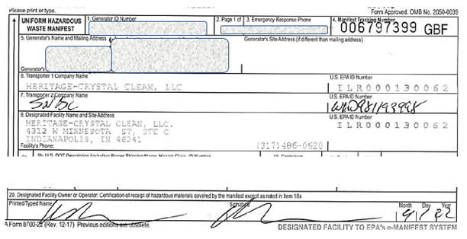
SUMMER BY THE SEA COLORING BOOK - PICTURE 4
‡
◊
Happenings
Data Quality
Notes:
I just said one reason I’m here. Data quality is a second reason. Poor data quality is becoming a rather consuming issue for all of us dealing with e-Manifest.
Let’s take a look at a single manifest that has crossed my desk. There are three vital errors on here. If someone can identify AND properly correct all three errors, I’ll give you $20. [This was an Iowa generated waste – so if this is your manifest – you are not eligible to claim the $20.]
Designated facility does not match its EPA ID number
Illegible designated facility person’s printed name
Illegible receipt date

Slide 10
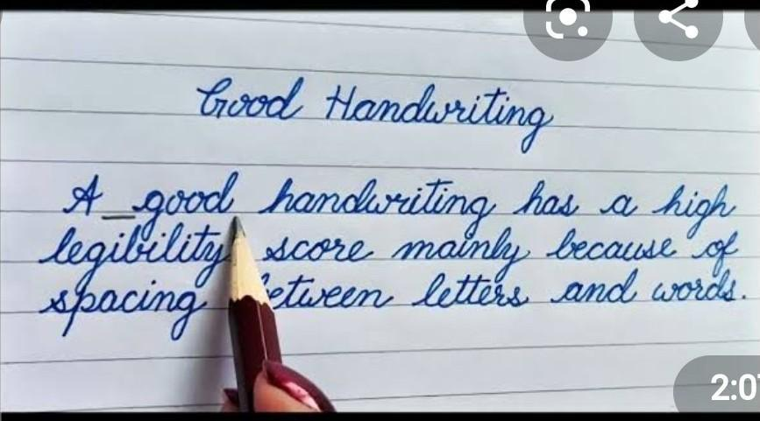
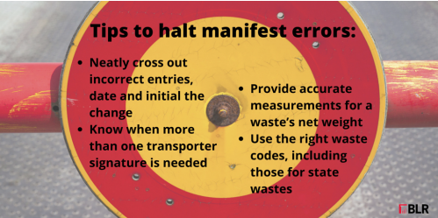
SUMMER BY THE SEA COLORING BOOK - PICTURE 4
◊
Happenings
Data Quality
Notes:
“Good Handwriting” image from https://brainly.in/question/37545400
“Tips to halt manifest errors” image from https://enviro.blr.com/environmental-news/waste/hazardous-waste-manifests/Hazardous-waste-manifest-tips

Slide 11

SUMMER BY THE SEA COLORING BOOK - PICTURE 4
‡
◊
Happenings
Data Quality
RCRA ID Numbers
Manifest Tracking Numbers
Digitization of paper manifests
Notes:
Compliance advisory available by click on image or go to https://www.epa.gov/system/files/documents/2023-03/e-manifest-advisory.pdf
This Compliance Advisory is intended to help you and others reduce data errors in the e-Manifest System. For the paper manifests that y’all use – the receiving TSDFs are doing the data entry. But you need to make sure they have good data to enter.
Reduced errors mean greater compliance. Greater compliance means less contact with EPA, LOL.
You might say, I ‘m here to lessen my enforcement colleagues’ workloads.
Let’s look at the data errors identified in this Advisory.

Slide 12






SUMMER BY THE SEA COLORING BOOK - PICTURE 2
‡
◊
Updates
Notes:
Quick sign image from https://www.facebook.com/QuickSign.in/
Remote (digital) signature image from https://www.thompsoncoburn.com/insights/publications/item/2020-03-30/electronic-signatures-and-remote-online-notarizations-during-covid-19
Record-keeping image from https://waldenenvironmentalengineering.com/the-importance-of-record-keeping/
RCRA Biennial Report image from https://chemicalsafety.com/waste-biennial-reporting/
So here are four kewl (at least to me and hopefully to you) reasons to register in e-Manifest. The speaker notes on this slide (below) provide specific details on how you can use Quick Sign and Remote Sign.
To access Quick Sign information – click on that icon
If an unsigned manifest has a "Scheduled" status and you are a Preparer, Certifier, or Site Manager for the generator, you will see the "Review and Quick Sign" or "Review and Sign" button, as appropriate, for that manifest. Depending on your site's role on the manifest, the system will ask you to confirm that you are the signer for one of these following sections:
Item 15. Generator's/Offeror's Certifications
Item 17. Transporter Acknowledgment of Receipt of Materials
Item 20. Designated Facility Owner or Operator: Certification of receipt of hazardous materials covered b the manifest except as noted in Item 18a
To confirm, click the "Quick Sign" button on the pop-up window to complete the signature process. If this is successful, the manifest status will be changed appropriately. Note: If you are signing as the generator, the manifest status will remain unchanged until the Initial Transporter signs the manifest. Once you have completed the signature process, you will return to the e-Manifest Dashboard.
Note: If you repeatedly answer your security question incorrectly, you will be prompted to reset all five of your security questions the next time that you login.
To access the Remote Sign Policy - click on that icon
Remote sign is available only for GEN, TRN and initial receipt of receiving facility

Slide 13


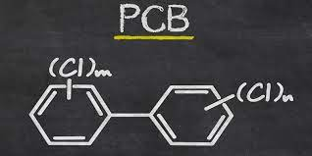
SUMMER BY THE SEA COLORING BOOK - PICTURE 2
‡
◊
Updates
My Waste
Notes:
PCB image from https://greentumble.com/what-are-pcbs-used-for
Rubber stamp image from https://www.etsy.com/ca/listing/918537684/4-x-4-rocker-mount-custom-rubber-stamp
“Where in the world “ image taken from https://m.imdb.com/title/tt0207938/mediaviewer/rm1588026368 and modified by author.
And three more reasons to be registered in e-Manifest!

Slide 14





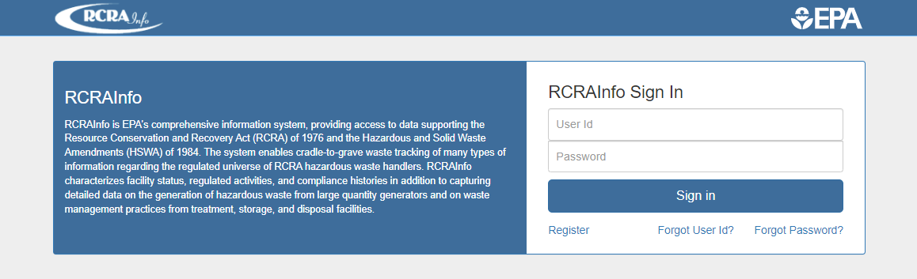
SUMMER BY THE SEA COLORING BOOK – PICTURE 3
‡
◊
Registering
Notes:
Google Chrome icon from https://play.google.com/store/apps/details?id=com.android.chrome&hl=en_US&pli=1
Firefox icon from https://play.google.com/store/apps/details?id=org.mozilla.firefox&hl=en_IN
In about the time I’ll spend on these next seven slides, you too can get registered in e-Manifest! Again, the speaker notes have all the prompts recorded.
It is best to use RCRA Info in either Chrome or Firefox. Historically, it doesn’t seem to like Internet Explorer. No idea why. No politics. It just doesn’t run well in that environment.
Click on RCRAInfo logo or go to https://rcrainfo.epa.gov/rcrainfoprod/action/secured/login
Click on Register
Click on Watch How-To for that registration video or go to https://rcrainfo.epa.gov/rcrainfo-help/videos/Create%20RIA%20Account/01-Create%20RIA%20Account.html

Slide 15
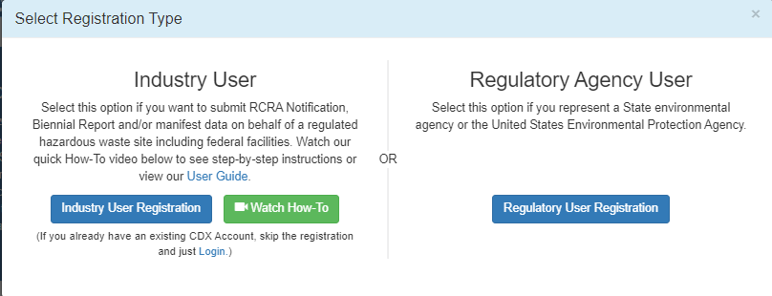

SUMMER BY THE SEA COLORING BOOK – PICTURE 3
‡
◊
Registering
Notes:
Click on RCRAInfo logo or go to https://rcrainfo.epa.gov/rcrainfoprod/action/secured/login
Click on Watch How-To for that registration video or go to https://rcrainfo.epa.gov/rcrainfo-help/videos/Create%20RIA%20Account/01-Create%20RIA%20Account.html
It all starts with getting a RCRA Info account. This part literally takes only 2-3 minutes.

Slide 16
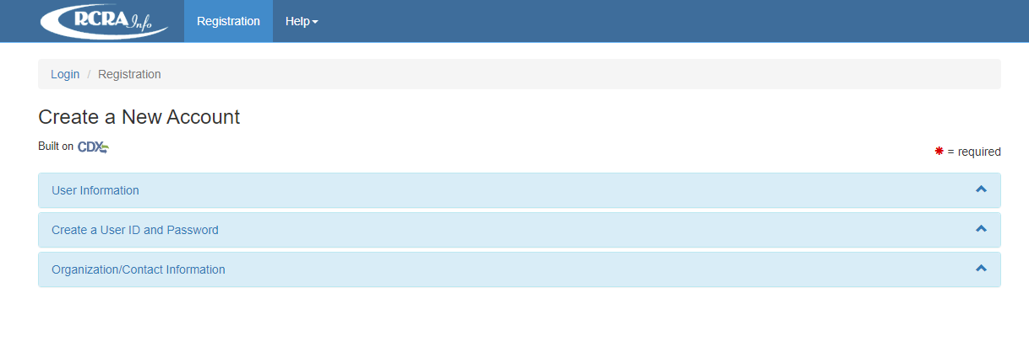
SUMMER BY THE SEA COLORING BOOK – PICTURE 3
‡
Registering
Notes:
There are three quick sets of info to fill to create a new account. These are:
Unser Information
*Create a User ID and Password
*Organization /Contact Information
Let’s do this!

Slide 17
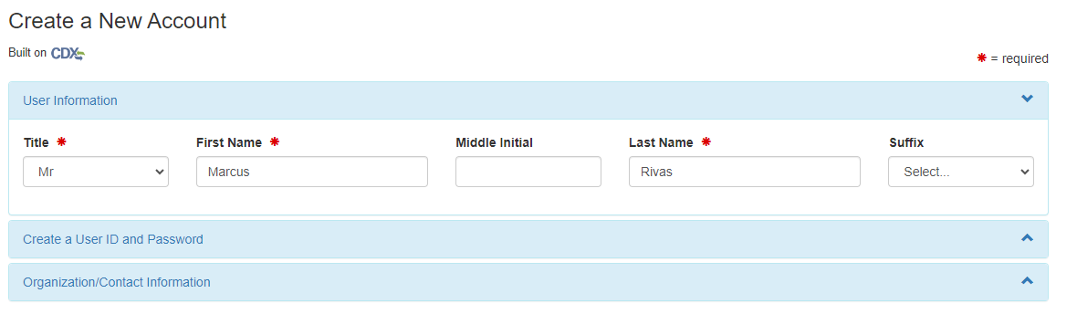
SUMMER BY THE SEA COLORING BOOK – PICTURE 3
‡
Registering
Notes:
Enter your User Information .

Slide 18
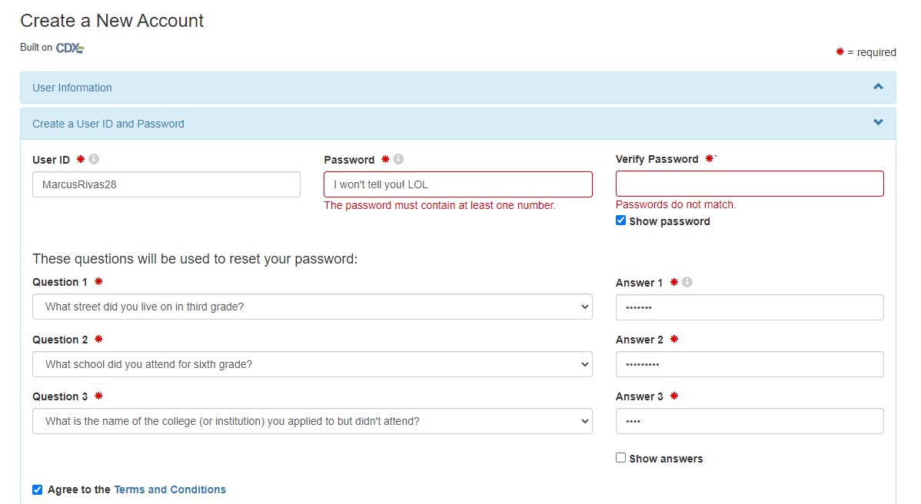
SUMMER BY THE SEA COLORING BOOK – PICTURE 3
‡
Registering
Notes:
No establish a User ID and password – and the usual security stuff (if you forget a password , RCRA Info can use you security features to get you in again).

Slide 19
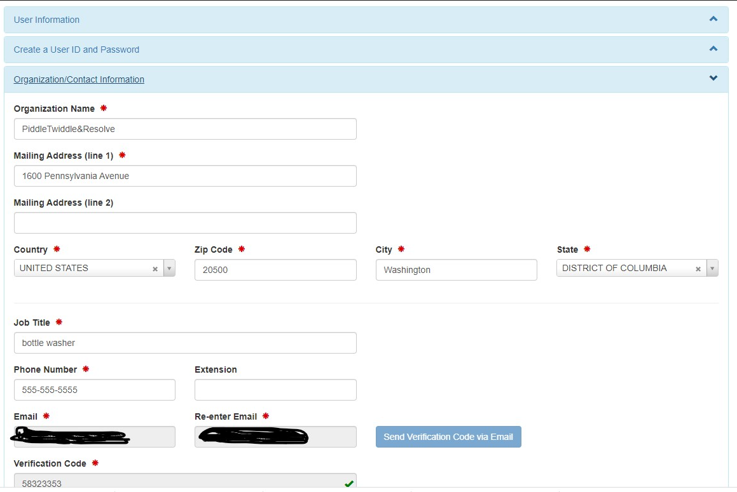
SUMMER BY THE SEA COLORING BOOK – PICTURE 3
‡
Registering
Notes:
After entering the verification code sent to the email you provided, you have a RCRA Info account. Now it’s a matter of associating it with your ID number. I won’t spend the time here showing that, but I can help you during this conference or at the close of this presentation, I’ll give you the contact info on moving forward.

Slide 20
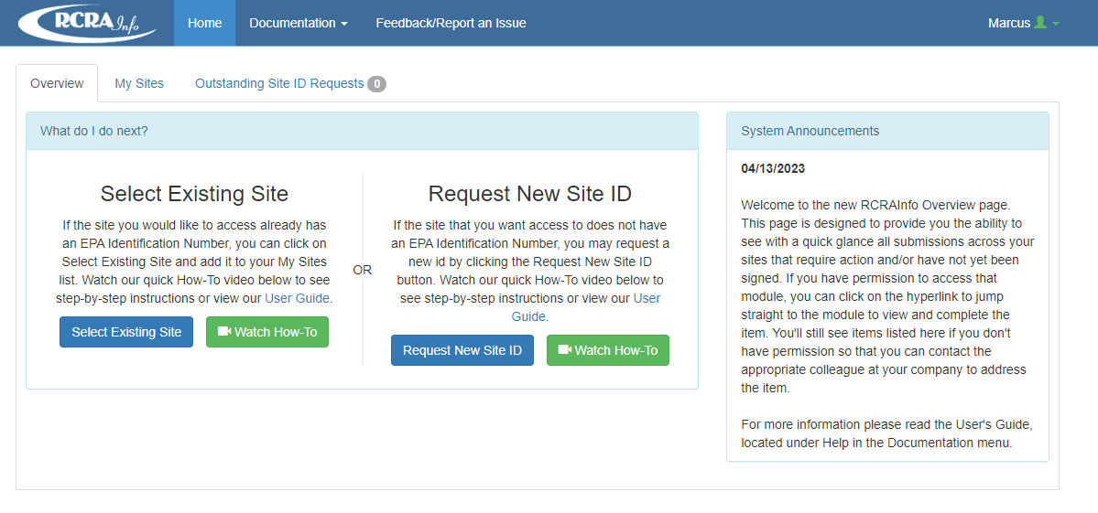
SUMMER BY THE SEA COLORING BOOK – PICTURE 3
‡
Registering
Notes:
I won’t spend the time here showing that, but I can help you during this conference or at the close of this presentation, I’ll give you the contact info on moving forward.

Slide 21

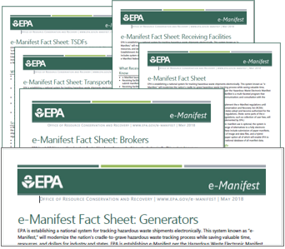
SUMMER BY THE SEA COLORING BOOK - PICTURE 4
‡
◊
Resources
How to Register for RCRAInfo Industry Application
e-Manifest Fact Sheets
Frequent Questions about e-Manifest
Notes:
Word document image from https://www.howtogeek.com/677873/how-to-open-microsoft-word-documents-without-word/
The “How to Register…” is an on-line illustrated guide (similar to some of the slide I just showed)
e-Manifest 2020 fact sheets may be found at https://www.epa.gov/ia/hazardous-waste-documents
Visit “Frequent Questions about e-Manifest” by clicking on that text or go to https://www.epa.gov/e-manifest/frequent-questions-about-e-manifest

Slide 22

‡
Notes:
Image from https://www.we-explore.org/en/
The “How to Register…” is an on-line illustrated guide (similar to some of the slide I just showed)
e-Manifest 2020 fact sheets may be found at https://www.epa.gov/ia/hazardous-waste-documents
Visit “Frequent Questions about e-Manifest” by clicking on that text or go to https://www.epa.gov/e-manifest/frequent-questions-about-e-manifest

Slide 23


SUMMER BY THE SEA COLORING BOOK - PICTURE 4
◊
Contact Us
Rivas.Marcus@epa.gov
Marcus Rivas
Thomas.Colleen@ epa.gov
Colleen Thomas
Notes:
Rules & Regulations image rom https://www.usfoodimports.com/what-we-do/for-importers/
Technical support image from https://www.freepik.com/vectors/technical-assistance

Slide 24

SUMMER BY THE SEA COLORING BOOK - PICTURE 4
‡
Notes:
Image from https://www.google.com/imgres?imgurl=https%3A%2F%2Fi.pinimg.com%2Foriginals%2F5d%2Fdd%2F5b%2F5ddd5bbd53f9e0b4dc367e0d938b565b.png&tbnid=Q8vbojq2XKz_cM&vet=12ahUKEwjZ0OvY867_AhX9I2IAHXCJA3QQMygMegUIARDoAQ..i&imgrefurl=https%3A%2F%2Fin.pinterest.com%2Fpin%2F771522979918864558%2F&docid=YXcuvSCA8QyfRM&w=640&h=360&q=powerpoint%20professional%20thank%20you%20images&hl=en&ved=2ahUKEwjZ0OvY867_AhX9I2IAHXCJA3QQMygMegUIARDoAQ
As I opened, so I close -- THANK YOU for inviting me here today! I greatly appreciate your time and attention to environmental stewardship. I look forward to working with you in the future.

