Slide 2
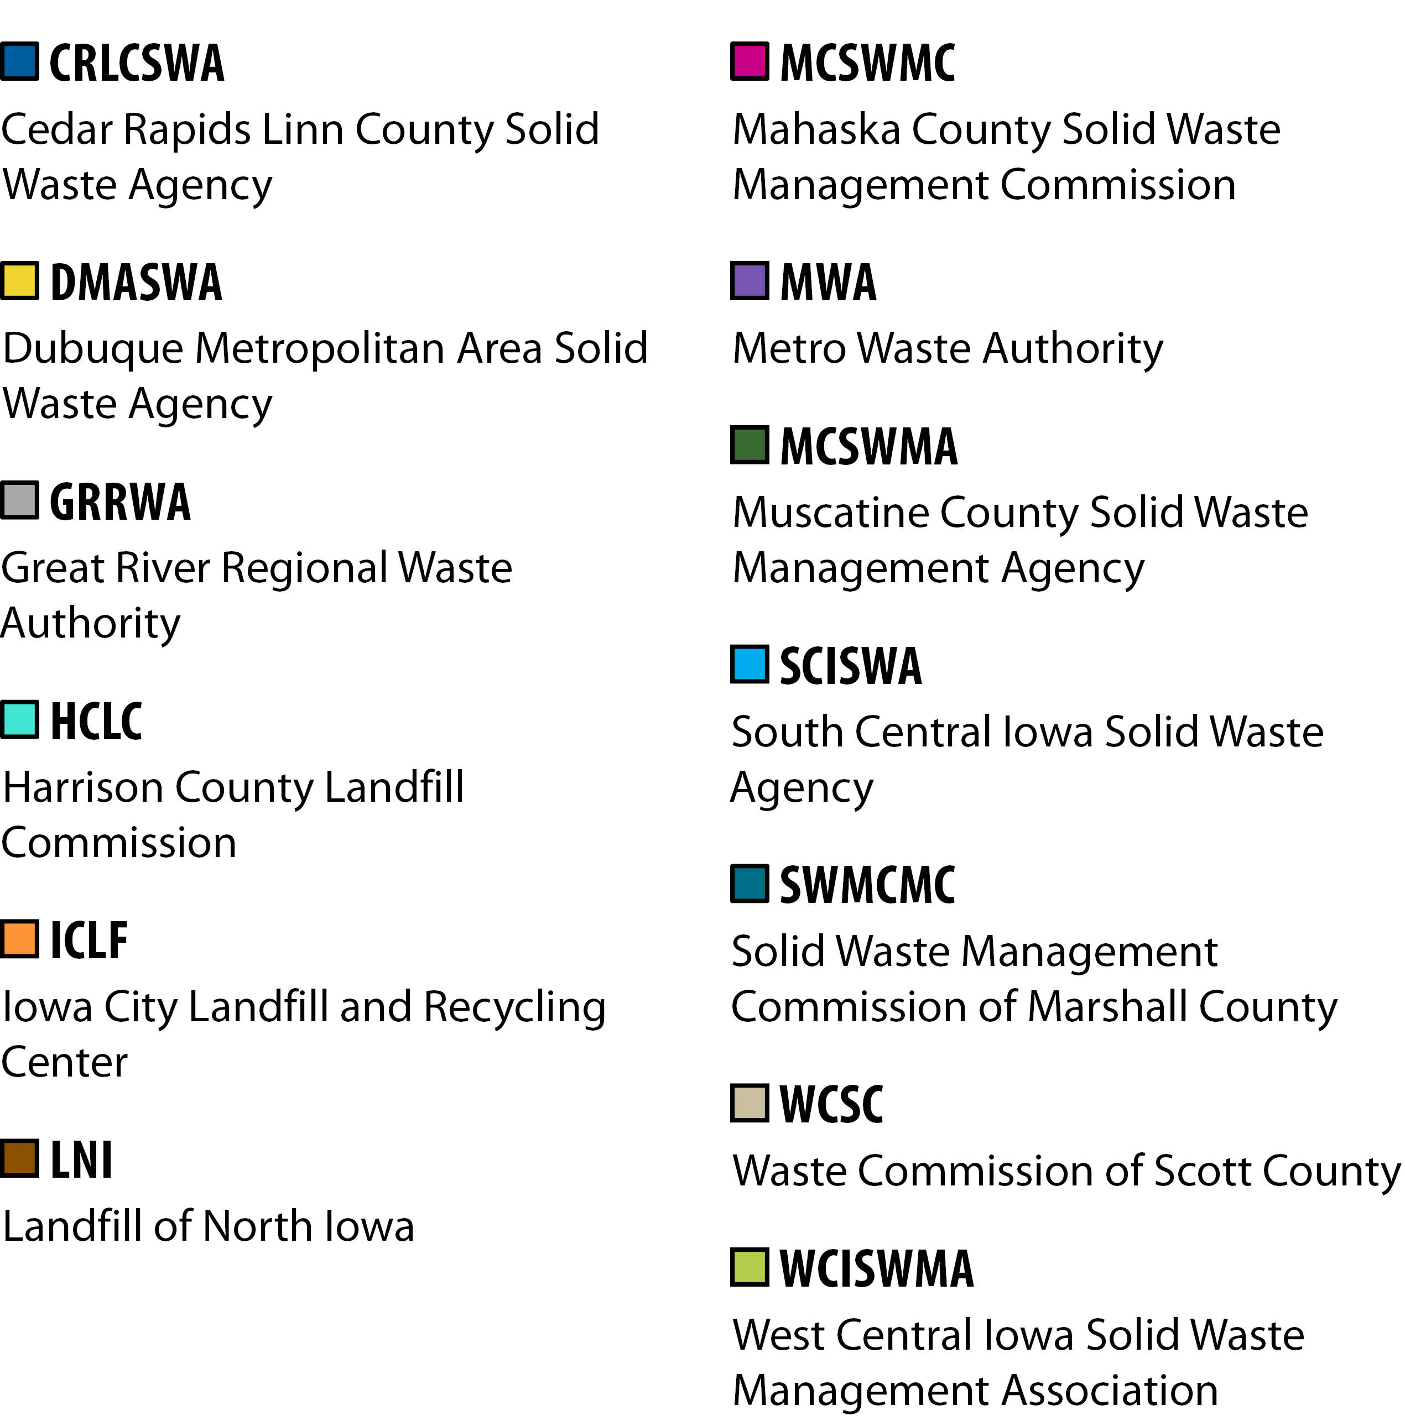
ACTIVELY PURSUING CONTINUOUS IMPROVEMENT
CRLCSWA
Cedar Rapids Linn County Solid Waste Agency
DMASWA
Dubuque Metropolitan Area Solid Waste Agency
GRRWA
Great River Regional Waste Authority
HCLC
Harrison County Landfill Commission
ICLF
Iowa City Landfill and Recycling Center
LNI
Landfill of North Iowa
MCSWMC
Mahaska County Solid Waste Management Commission
MWA
Metro Waste Authority
MCSWMA
Muscatine County Solid Waste Management Agency
SCISWA
South Central Iowa Solid Waste Agency
SWMCMC
Solid Waste Management Commission of Marshall County
WCSC
Waste Commission of Scott County
WCISWMA
West Central Iowa Solid Waste Management Association
Notes:
Text: Actively pursuing continuous improvement as a voluntary participant in the DNR’s Iowa Solid Waste Environmental Management System (EMS) program—a network of 16 working towards environmental stewardship goals beyond waste reduction.
Link: https://www.iowadnr.gov/Environmental-Protection/Land-Quality/Waste-Planning-Recycling/Solid-Waste-EMS

Slide 3
Minimizing environmental risks.
Promoting environmental stewardship.
Supporting environmental efforts of communities and stakeholders.
ENVIRONMENTAL IMPACT

Slide 4
ENVIRONMENTAL STEWARDSHIP
Organics Management
Greenhouse Gas Reduction
Household Hazardous Materials Collection
Recycling Services
Water Quality Improvement
Environmental Education
Notes:
Text: Encouraging responsible environmental management while promoting continuous improvement in 6 environmental component areas as an Environmental Management System (EMS) within the DNR’s voluntary program.
Link: https://www.iowadnr.gov/Environmental-Protection/Land-Quality/Waste-Planning-Recycling/Solid-Waste-EMS

Slide 5
CONTINUOUS IMPROVEMENT
Following the proven continuous improvement cycle to make environmental change — as an Environmental Management System (EMS) within the DNR’s voluntary program.
Notes:
Link: https://www.iowadnr.gov/Environmental-Protection/Land-Quality/Waste-Planning-Recycling/Solid-Waste-EMS

Slide 6
ENVIRONMENTAL MANAGEMENT SYSTEM
Implementing a framework of 10 elements
Environmental Policy
Environmental Impacts
Objectives & Targets
Action Plan
Roles & Responsibilities
Communication, Training & Awareness
Legal & Other Requirements
Revaluation & Modification
Assessment
Monitoring & Measurement
Notes:
Note: Colors correlate to the continuous improvement cycle wheel.

Slide 7
ENVIRONMENTAL MANAGEMENT SYSTEM
Environmental Policy
Environmental Impacts
Objectives & Targets
Legal & Other Requirements
Action Plan
Implementing a framework of 10 elements
Roles & Responsibilities
Communication, Training & Awareness
Monitoring & Measurement
Assessment
Reevaluation & Modification

Slide 8
ENVIRONMENTAL MANAGEMENT SYSTEM
Environmental Policy
Environmental Impacts
Objectives & Targets
Legal & Other Requirements
Action Plan
Implementing a framework of 10 elements
Roles & Responsibilities
Communication, Training & Awareness
Monitoring & Measurement
Assessment
Reevaluation & Modification

Slide 9
Environmental Management System
By Implementing a Framework of 10 Elements
For Continuous Improvement
Environmental Policy
Actively Pursuing Six Program Components
Environmental Impacts
Objectives & Targets
Legal & Other Requirements
Organics Management
Action Plan
Household Hazardous Materials Collection
Roles & Responsibilities
Greenhouse Gas Reduction
Communication, Training & Awareness
Recycling Services
Monitoring & Measurement
Water Quality Improvement
Assessment
Environmental Education
Reevaluation & Modification

Slide 10
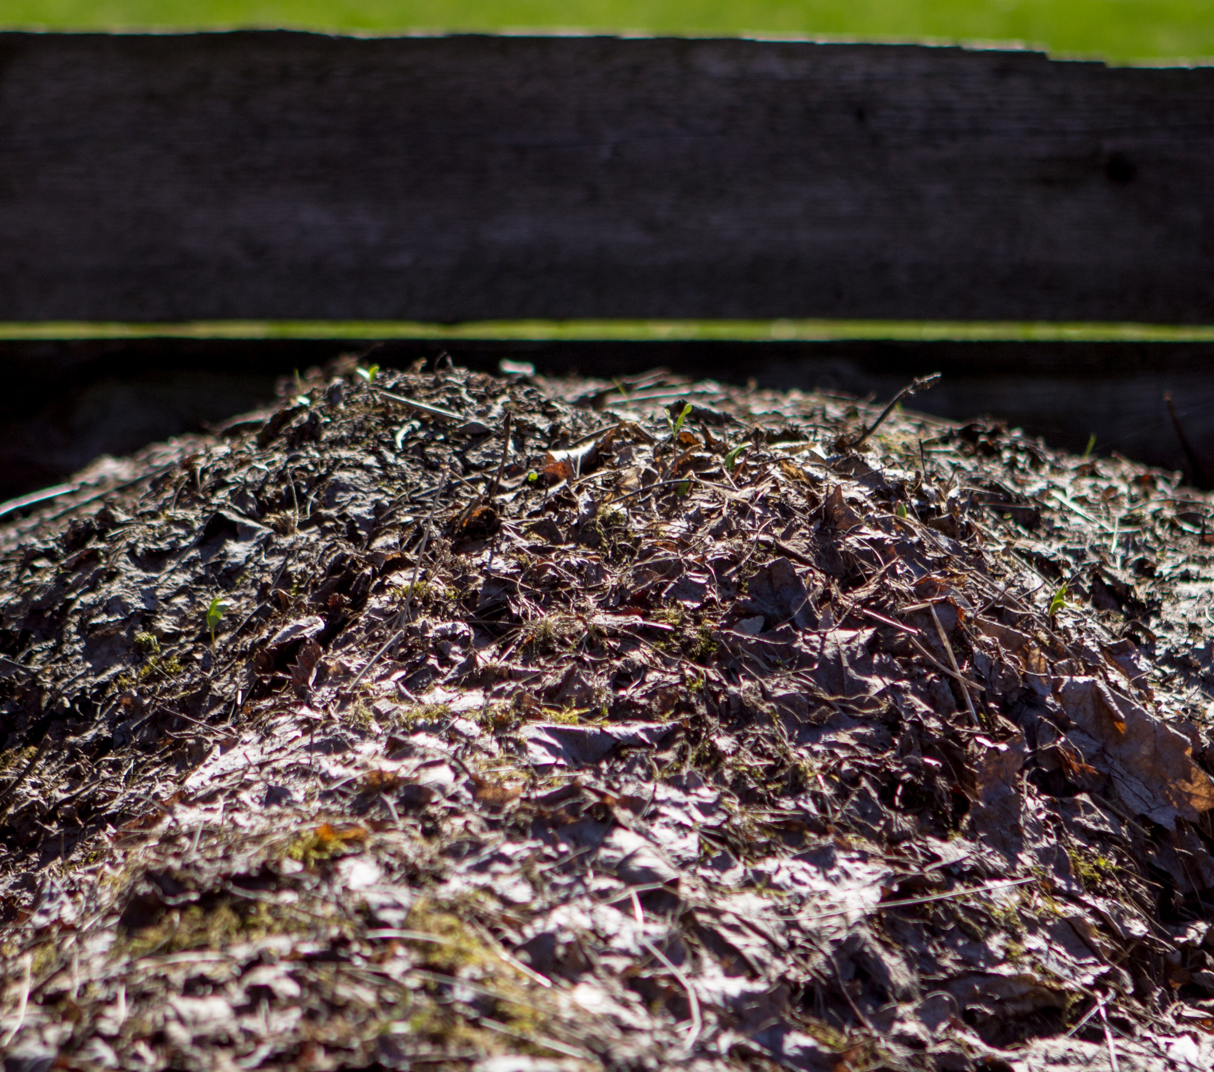
Organics Management
By separately processing organics for compost, mulch or other uses, emissions are significantly reduced, space within the landfill is saved and useful materials are generated.
Notes:
Combine an image and a key statements for the environmental component area

Slide 11
IMPROVEMENTS
Improvements to composting facilities have resulted in an increase in the amount and quality of the organics collected.
Notes:
Tip:
When using complex image as full-bleed background add a transparency (70%-90%) fill layer to give contrast to text.

Slide 12
Household Hazardous Materials Collection
Rechargeable batteries may spark fires when mixed with recyclables or disposed in a landfill.
Notes:
Combine an image and a key statements for the environmental component area

Slide 13
FACILITY IMPROVEMENTS
Facility improvements and accessibility resulted in greater ease of HHM collection.

Slide 14
Water Quality
Raising awareness of water quality issues and encouraging responsible environmental behaviors help to preserve and improve water quality.
Notes:
Combine an image and a key statements for the environmental component area

Slide 15
Recycling Services
By collecting and processing these materials separately, energy is saved, greenhouse gas emissions are avoided, and space within the landfill is preserved.
Notes:
Combine an image and a key statements for the environmental component area

Slide 16
Greenhouse Gas Reduction
Efforts to improve energy efficiency or switch to renewable energy sources reduce reliance on fossil fuels.
Notes:
Combine an image and a key statements for the environmental component area

Slide 17
Environmental Education
Education not only supports the goals in each of the EMS component areas but improves beneficial outcomes.
Notes:
Combine an image and a key statements for the environmental component area

Slide 18
HOW TO GET STARTED
1
Customize slides
2
Save slides as image files
Edit the slides we’ve created (e.g., add your logo, replace photos with your own) and/or take materials from those to use in your layouts.
For slides with additional steps to edit, we have added more information in the notes section
Tip | Use the built-in-color palette with green and black for callouts and accents
Click on the File ribbon and select the Save As option.
Choose an image format (PNG recommended for the best quality) from the file format dropdown. From there, you can even choose to save the current individual slide or the whole presentation.

Slide 19
FURTHER CUSTOMIZATION
1
Apply a layout
2
Change the size
On the Home tab on the ribbon, select Layout and then choose a layout.
Tip | Play around with applying different layouts to existing slides for a different spin
On the Home tab on the ribbon, select Design and then select custom size under the Slide Size dropdown.
Select the desired size.
Tip | See the next slide for the best sizes/formats to use for various social media platforms.

Slide 20
BEST SOCIAL MEDIA IMAGE SIZES
Instagram
Twitter
Facebook
Square images: 1,080 x 1,080 pixels
Horizontal (landscape) images: 1,080 x 566 pixels
Vertical (portrait) images: 1,080 x 1,350 pixels
Instagram Stories: 1,080 x 1,920 pixels
Single horizontal image: 1,200 x 675 pixels
Multiple horizontal images: 1,200 x 675 pixels
Links with an image: 800 x 418 pixels
Horizontal images: 1,200 x 630 pixels
Vertical images: 1,080 x 1,350 pixels
Links with an image: 1,200 x 630 pixels
Facebook Stories: 1,080 x 1,920 pixels
Notes:
Sizes may vary depending on desired pixels. Typical pixel per inch = 96.

Slide 21
FONTS & COLORS USED
This presentation has been made using the following font:
Open Sans
(https://fonts.google.com/specimen/Open+Sans)
#353537
#396A32
#E3E6A9
#C4CC3C
#A400BF
#00ACEC
#FF993F
#8B5000
#A8A8A6

